Slide 1
Install web server
簡廷因 Ting-Ying Chien
2021.09.23

Slide 2
Outline
Install XAMPP server (windows)
Apache
PHP
MariaDB (MySQL)
Install apache server (linux)

Slide 3

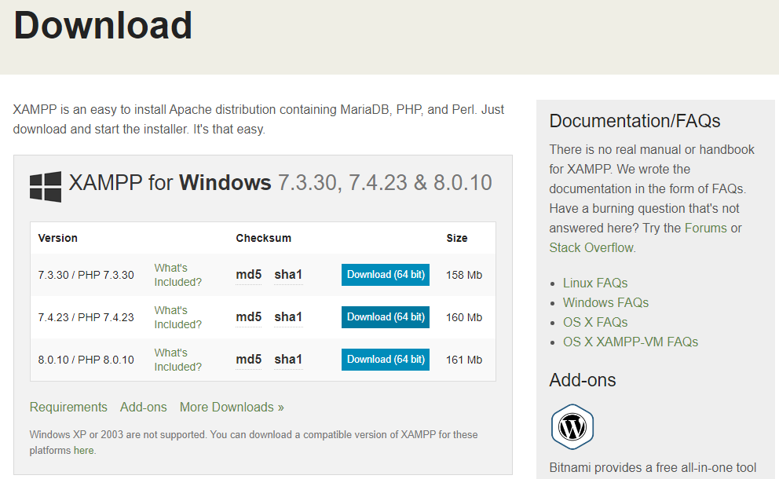
Install server
Download XAMPP
https://www.apachefriends.org/zh_tw/index.html

Slide 4
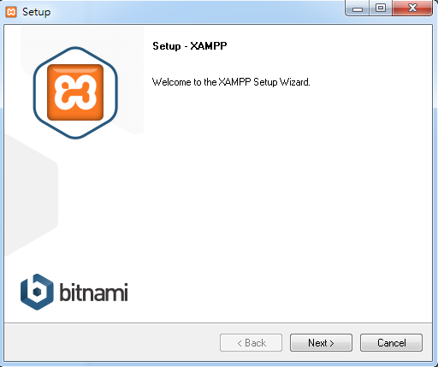
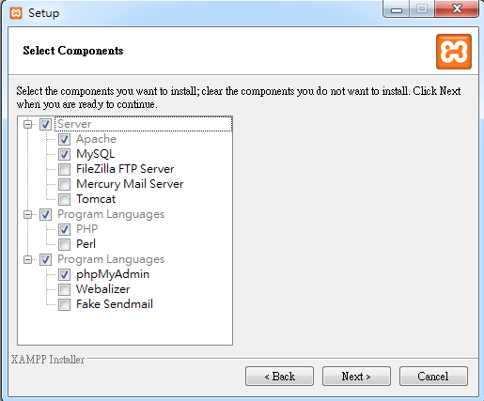
Install server
Apache / MySQL / PHP / phpMyAdmin

Slide 5
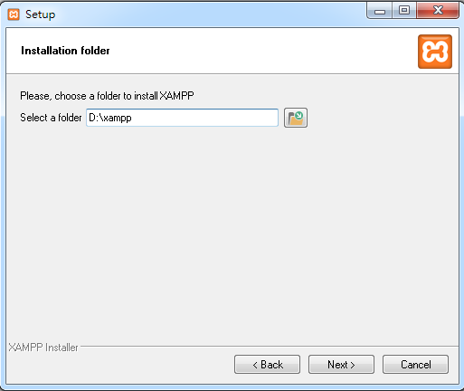
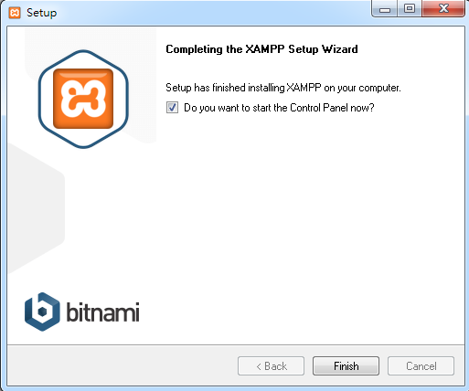
Install server

Slide 6
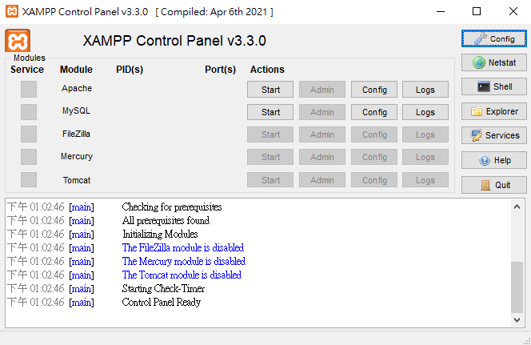
Install server

Slide 7
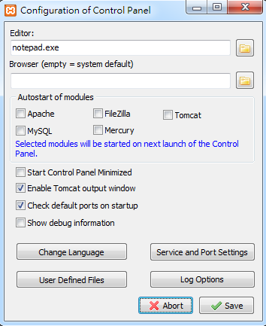
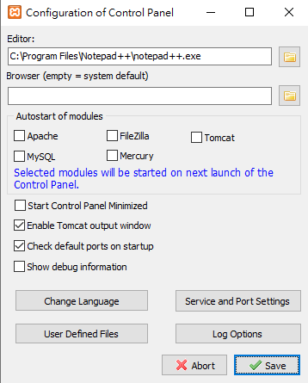
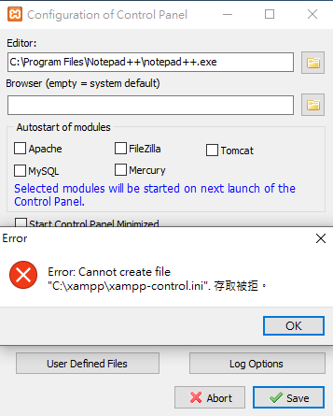
Install server
C:\Program Files\Notepad++\notepad++.exe

Slide 8
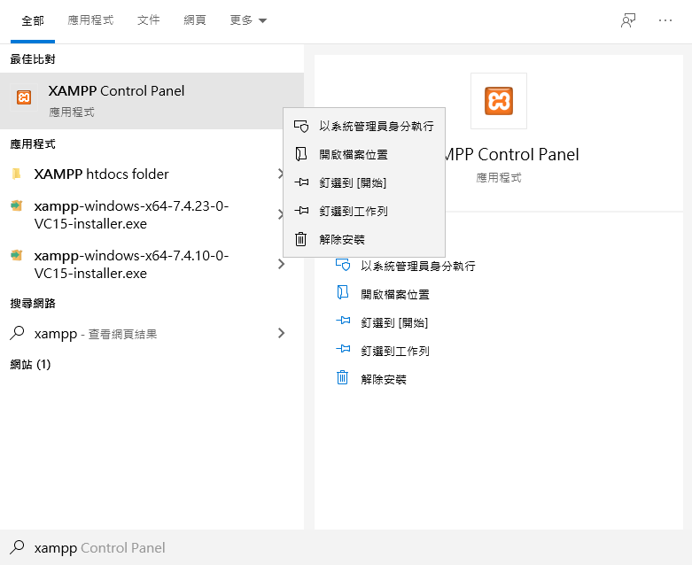
Install server
關掉xampp -> 搜尋xampp->滑鼠右鍵->以系統管理員身分執行

Slide 9
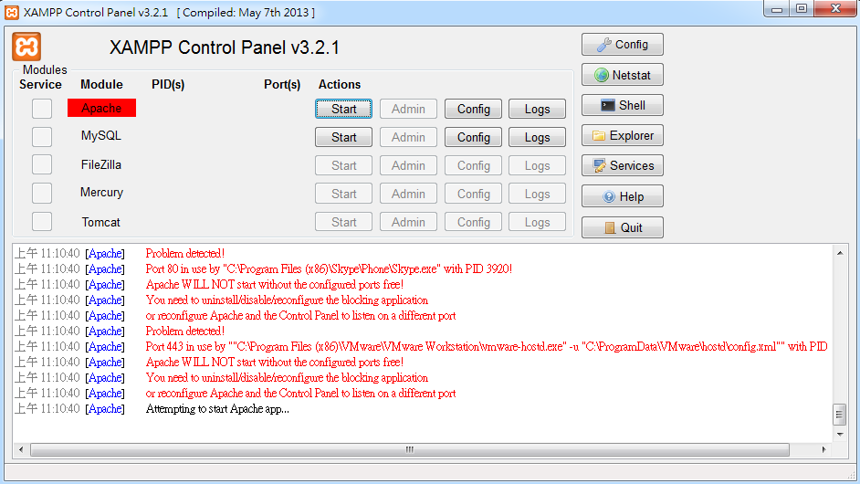
Install server
(optional) Apache Error
Modify config

Slide 10
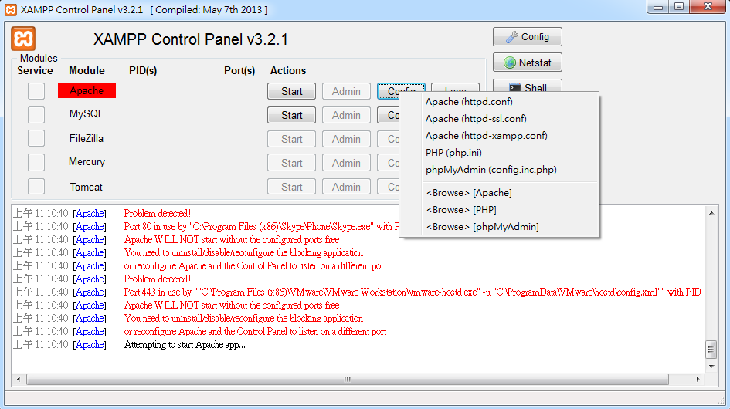
Install server
(optional) Apache Error
Port 80 error -> httpd.conf
Port 443 error -> httpd-ssl.conf

Slide 11
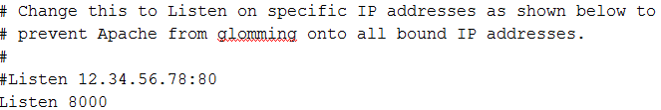
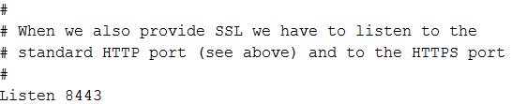
Install server
(optional) Apache Error
httpd.conf
httpd-ssl.conf

Slide 12
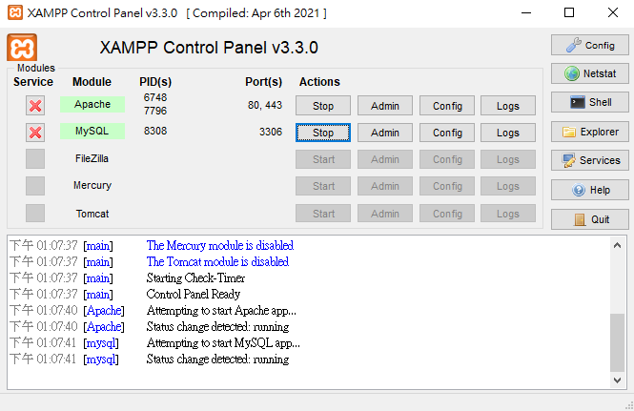
Install server

Slide 13
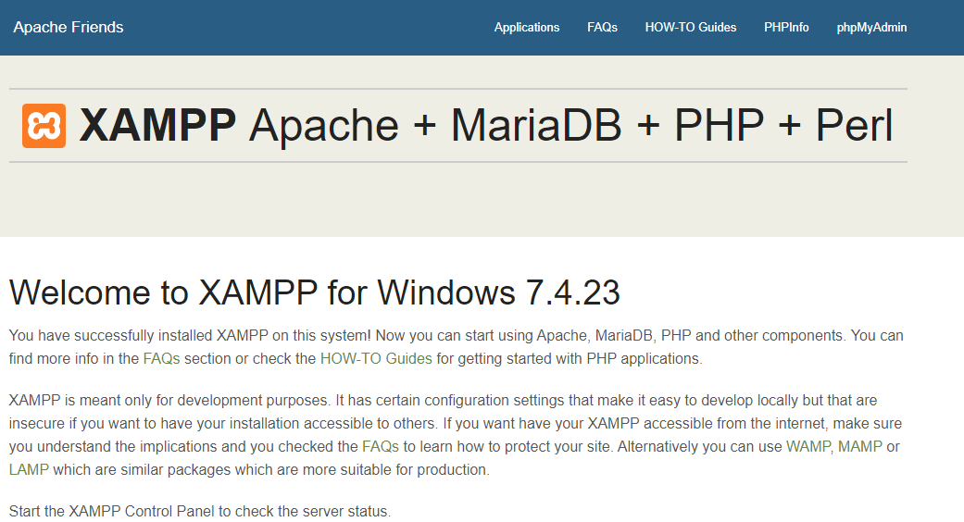
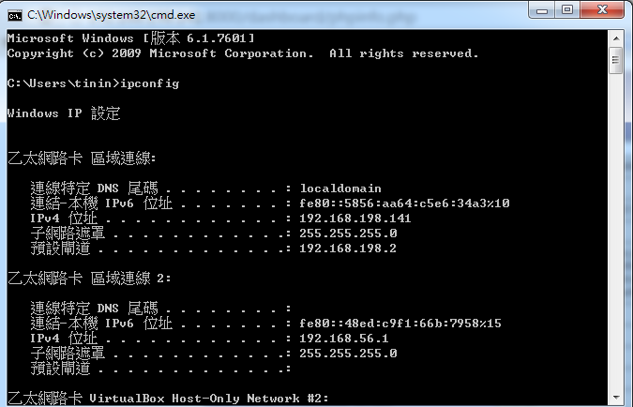
Install server
Server URL:
http://YOURIP:PORT/ or http://localhost:PORT
開始->執行->cmd->ipconfig
1201A教室 : 140.138.145.xx ~ 140.138.145.xx

Slide 14
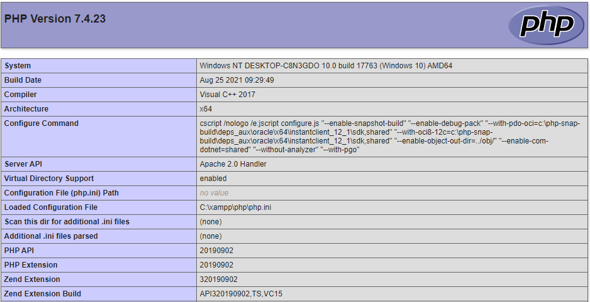
Install server
Check PHP

Slide 15
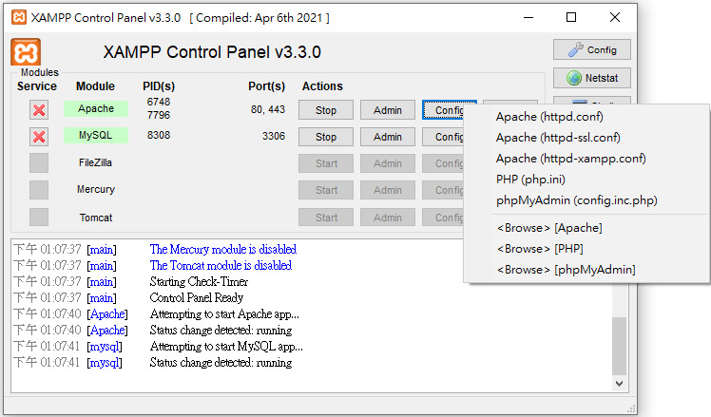
Install server
Apache configuration
INSTALL DIR/apache/conf/httpd.conf
ServerRoot #安裝位置
Listen # Port 預設80
DocumentRoot #網頁檔案位置
INSTALL DIR/htdocs #預設網頁檔案位置
C:/xampp/htdocs

Slide 16
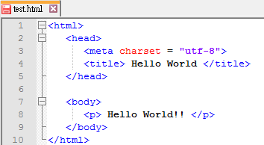
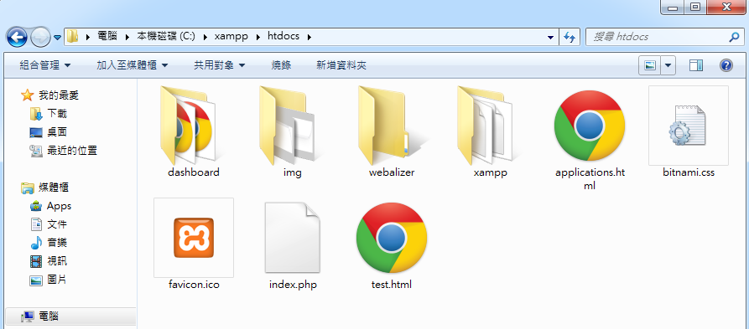
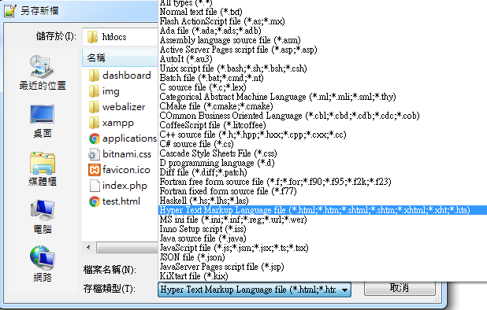
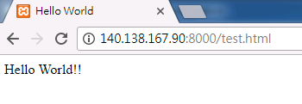
Install server
Example: test.html
<html>
<head>
<meta charset = "utf-8">
<title> Hello World </titlhead>
<body>
<p> e>
</Hello World!! </p>
</body>
</html>
Test Server
“存檔類型”要改成”html”

Slide 17
Install server
Setup 404 Error
Windows (Xampp)
INSTALL DIR/apache/conf/httpd.conf
Add file : INSTALL DIR/htdocs/missing.html
Linux (apache)
/etc/apache2/conf-available/localized-error-pages.conf
Add file : /var/www/html/missing.html
#ErrorDocument 404 /missing.html
ErrorDocument 404 /missing.html
(For XAMPP)
Include conf/extra/httpd-multilang-errordoc.conf
#Include conf/extra/httpd-multilang-errordoc.conf

Slide 18
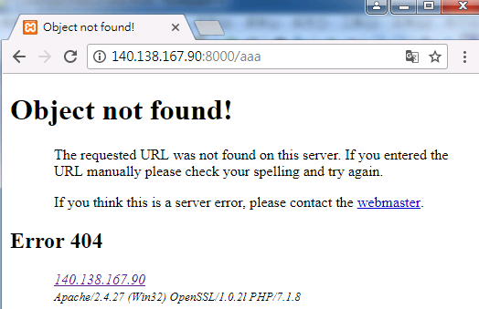
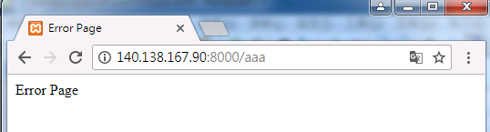
Install server
Example: missing.html
<html>
<head>
<meta charset = "utf-8">
<title> Error Page </title>
</head>
<body>
<p> Error Page </p>
</body>
</html>

Slide 19
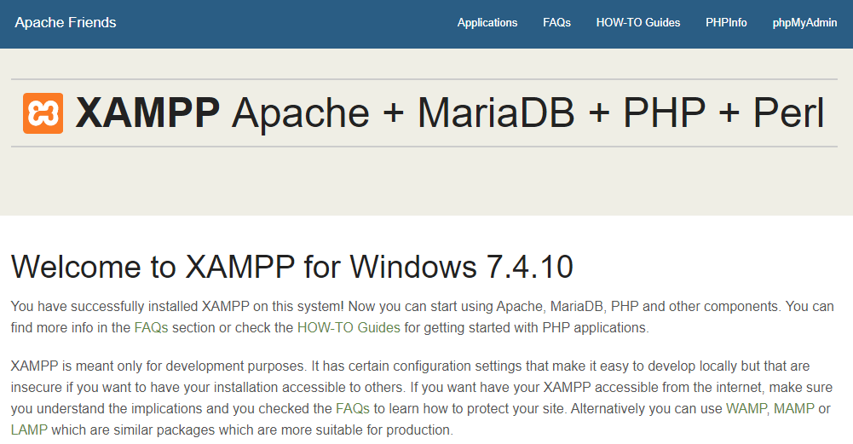
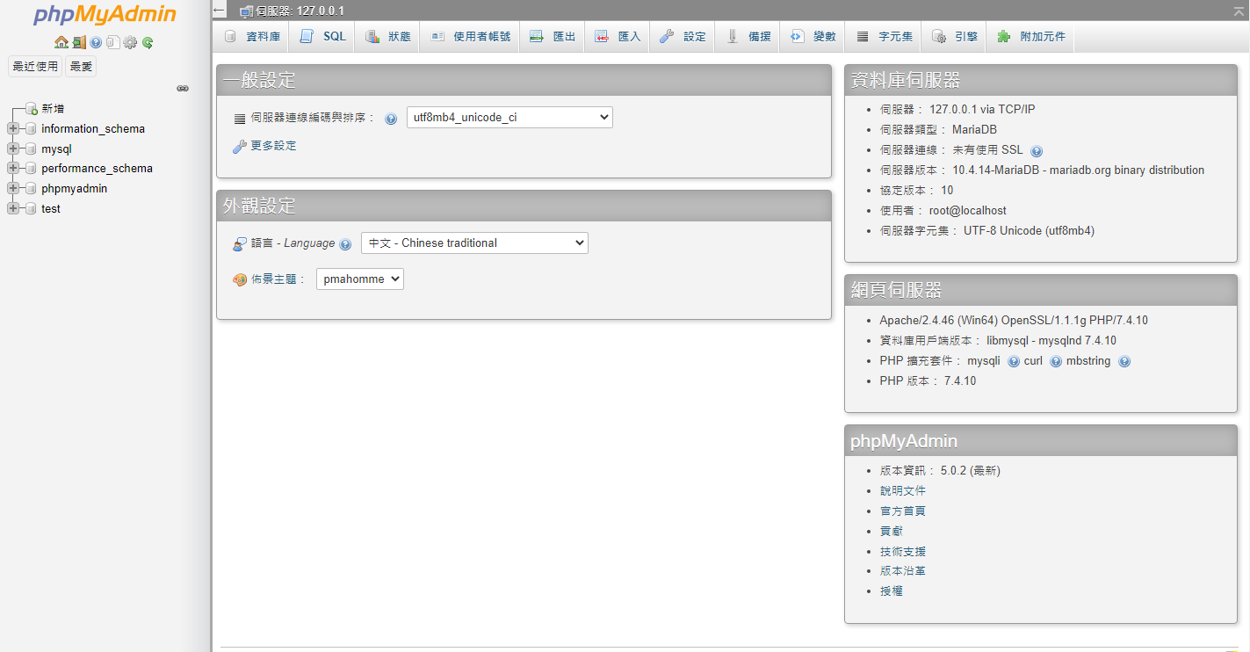
Install server
Check MySQL
http://YOURIP:PORT/phpmyadmin

Slide 20
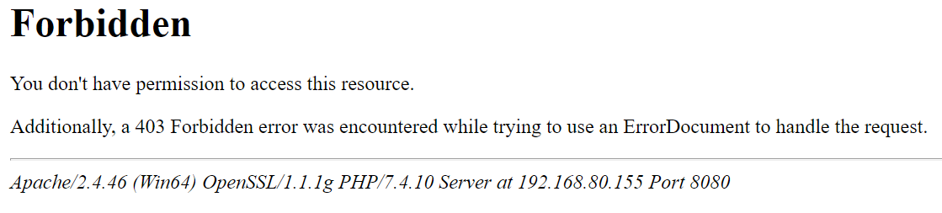
Install server
(optional) Access forbidden!
Modify httpd-xampp.conf

Slide 21
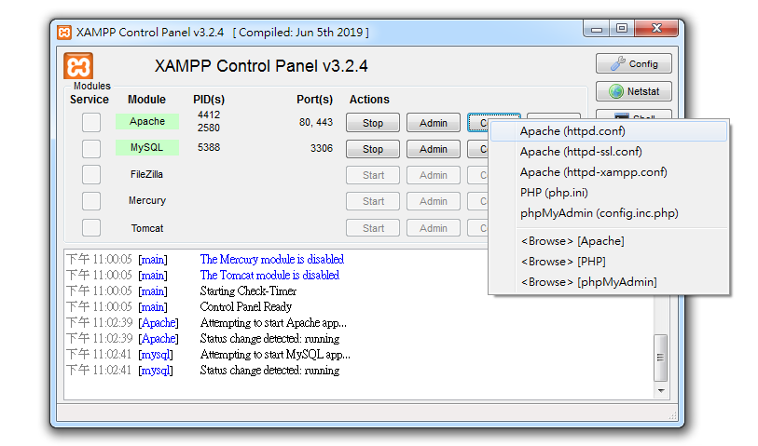
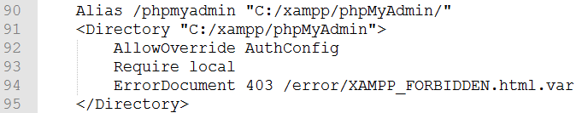
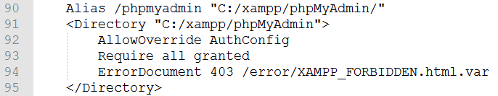
Install server
(optional) Access forbidden!
After modify the file, restart apache

Slide 22
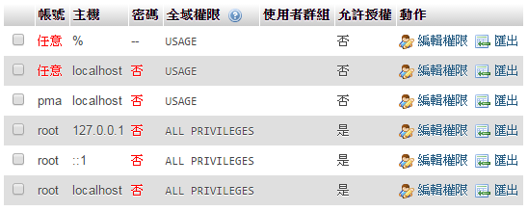
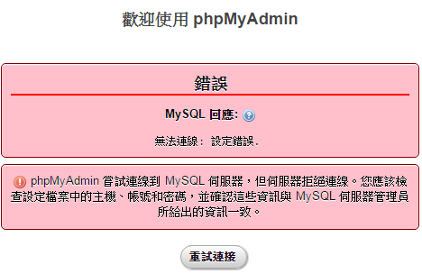
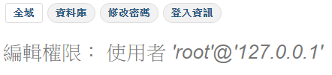
Install server
Set root password
使用者 -> root -> 編輯權限 ->修改密碼
主機 127.0.0.1, ::1, localhost 都要改

Slide 23
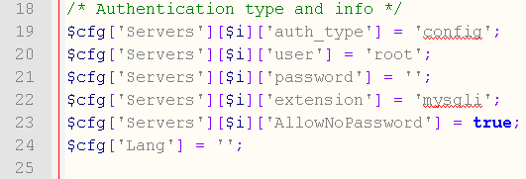
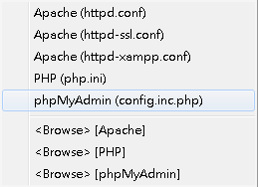
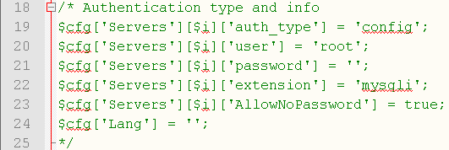
Install server
Login with password
Modify phpMyAdmin (config.inc.php)

Slide 24
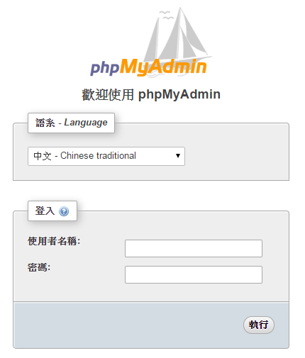
Install server

Slide 25
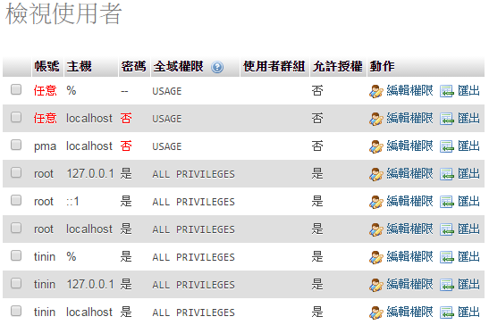
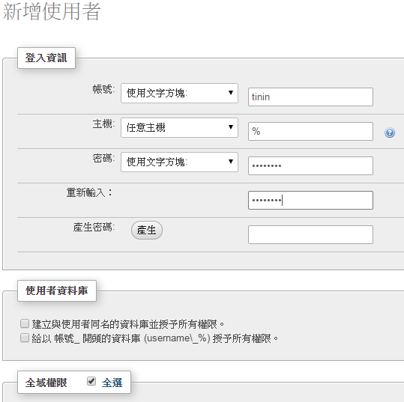
Install server
Add super user
新增使用者
全域權限
全選
執行

Slide 26
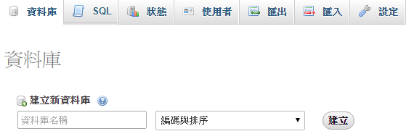
Install server
Create a database

Slide 27
No-IP
Sign in and confirm
https://www.noip.com/

Slide 28
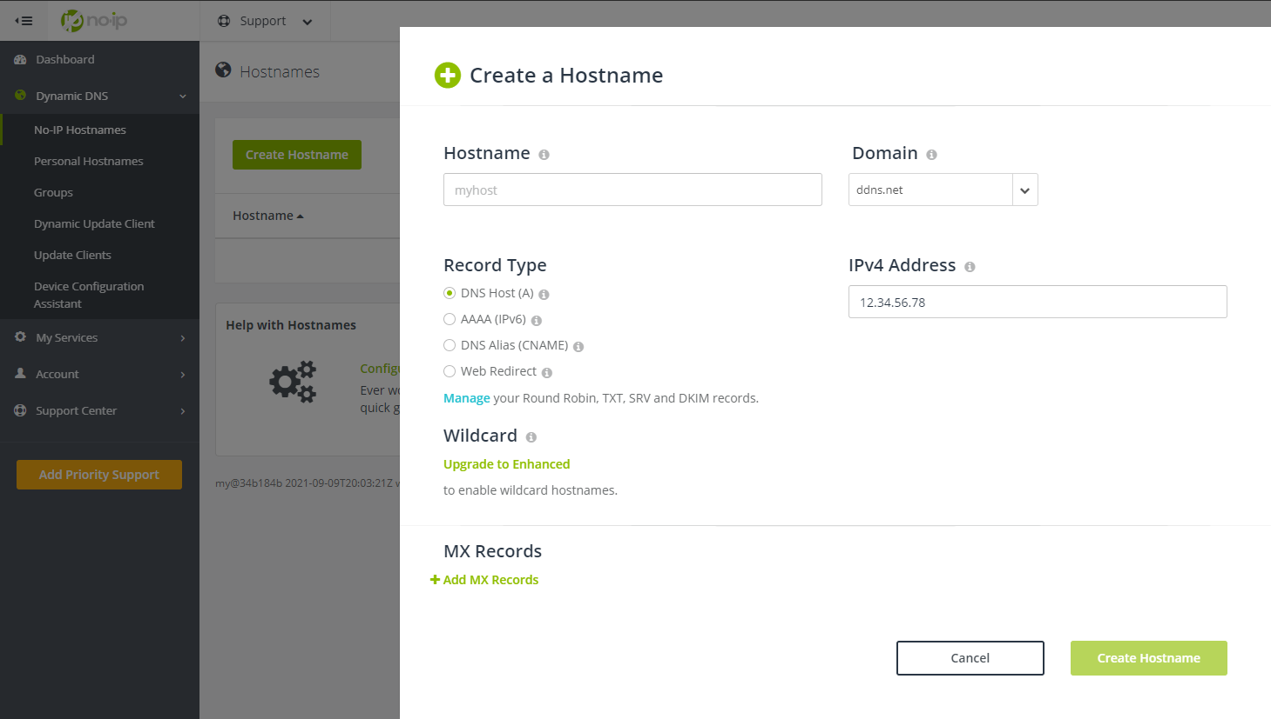
No-IP
Add a host

Slide 29
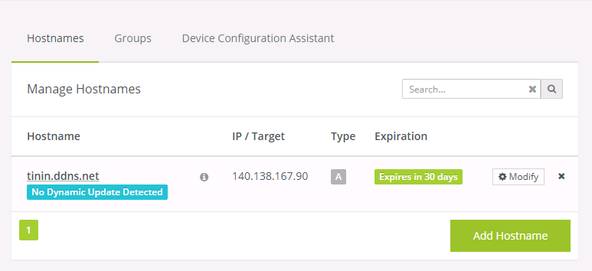
No-IP

Slide 30
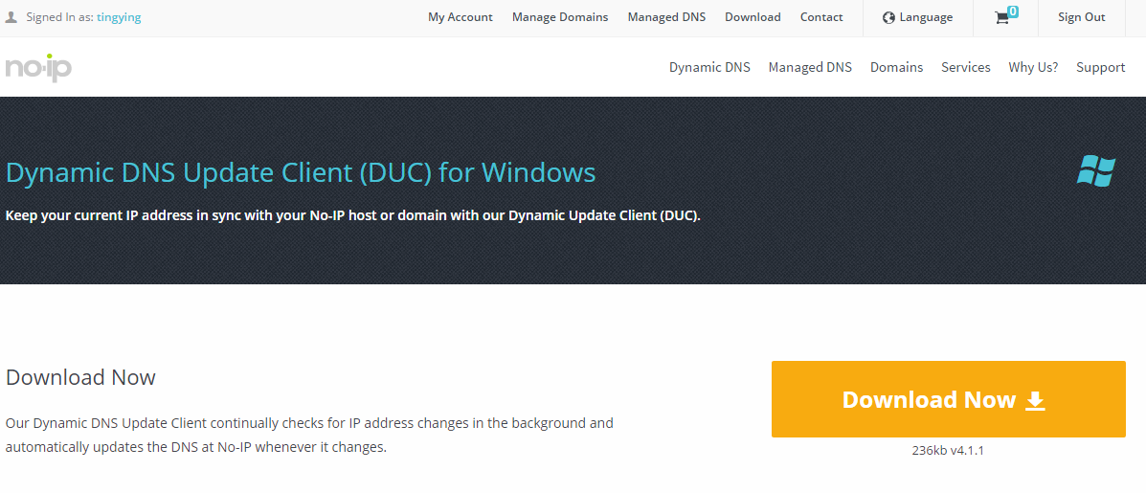
No-IP
Download dynamic DNS update client
http://www.noip.com/download?page=win
浮動IP使用

Slide 31
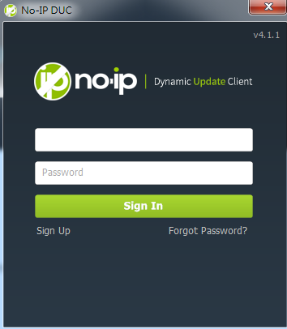
No-IP
Login DUC

Slide 32
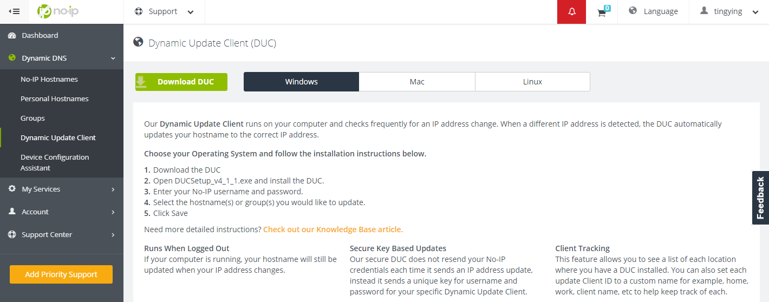
No-IP

Slide 33
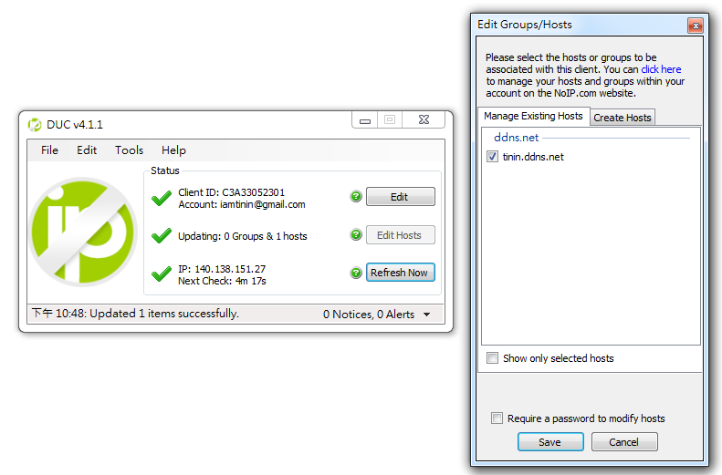
No-IP
DUC
Edit Hosts

Slide 34
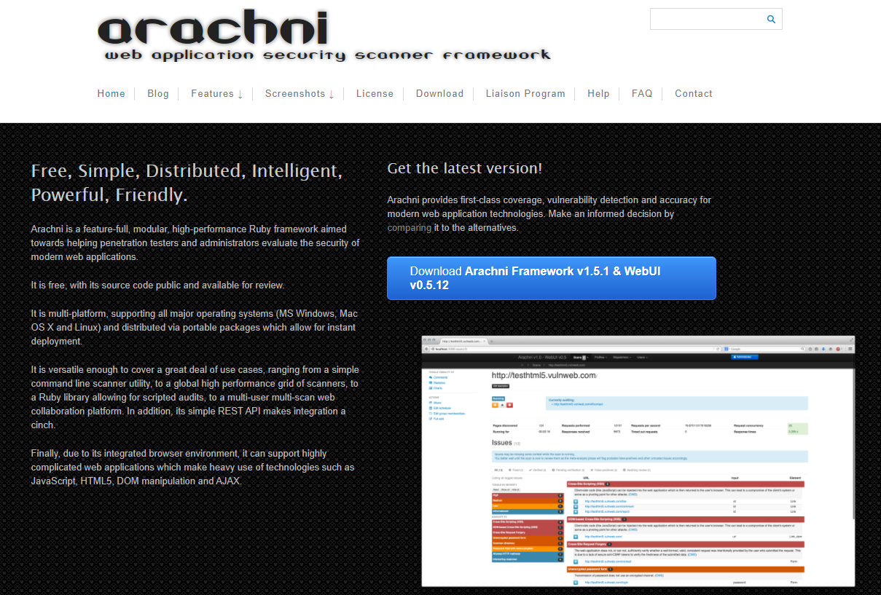
Arachni
Arachni
Web security scanner framework
https://www.arachni-scanner.com/

Slide 35
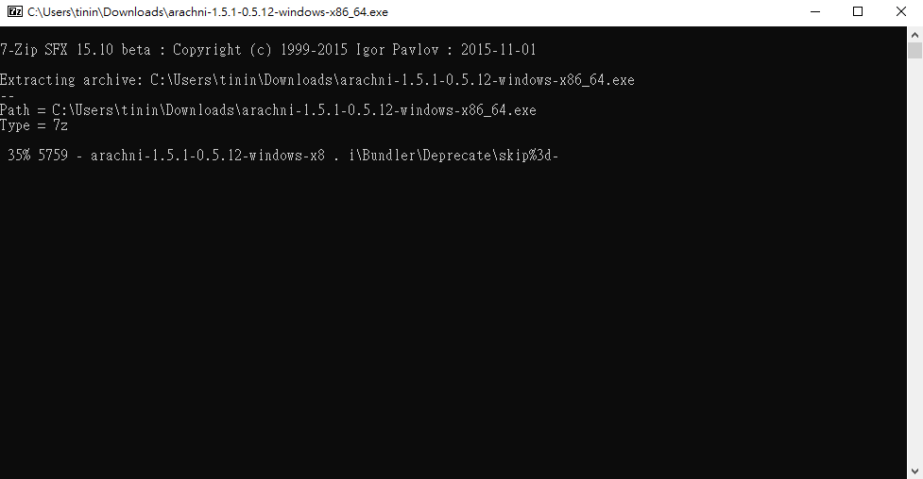
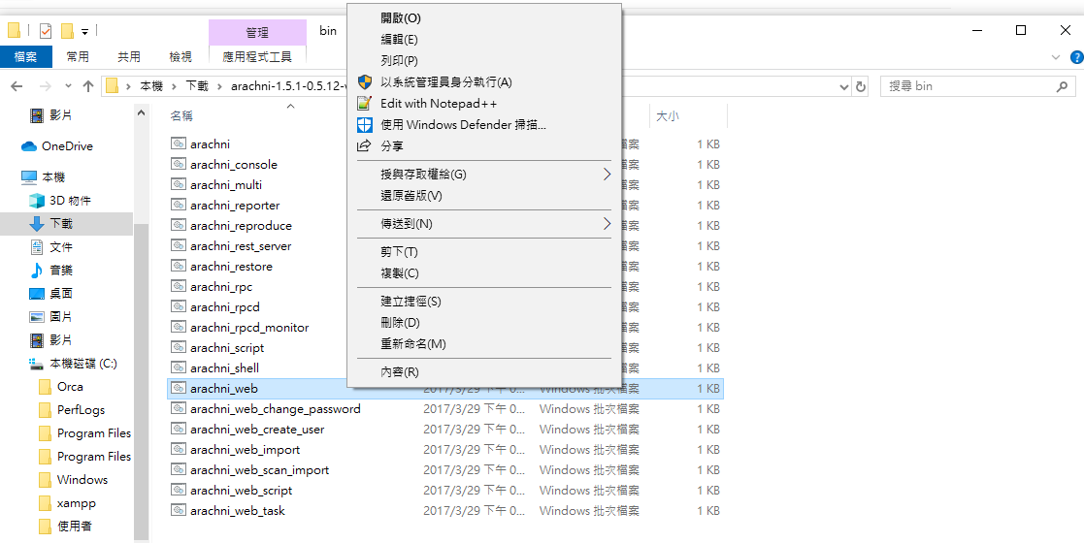
Arachni
arachni-1.5.1-0.5.12-windows-x86_64\bin

Slide 36


Arachni
http://localhost:9292
E-mail: admin@admin.admin
Password: administrator

Slide 37


Arachni

Slide 38

Arachni

Slide 39
Install apache server (linux)

Slide 40

Install apache server (linux)
Download Ubuntu 18.04
http://ftp.cse.yzu.edu.tw/Linux/ubuntu-cdimage/ubuntu/18.04.3/ubuntu-18.04.3-live-server-amd64.iso
Vmware Player
Create a New Virtual Machine

Slide 41


Install apache server (linux)
Personal information
User name
Password
Install Location
Please select D:\Web\

Slide 42


Install apache server (linux)
Specify Disk Capacity
40GB
Finish
Check Network Adapter : NAT

Slide 43

Install apache server (linux)

Slide 44

Install apache server (linux)

Slide 45

Install apache server (linux)
Login
To return to your computer, press Ctrl+Alt

Slide 46
Install apache server (linux)
mkdir public_html #建立資料夾
mkdir html
sudo –s #變更使用者為root
apt-get update #更新套件資料庫
apt-get install openssh-server #安裝ssh server

Slide 47


Install apache server (linux)
Connect to server
Pietty
http://ntu.csie.org/~piaip/pietty/
ifconfig #查詢server IP

Slide 48
Install apache server (linux)
sudo –s #變更使用者為root
apt-get install vim #安裝vim 文字編輯器
apt-get install apache2 #安裝apache server

Slide 49
Install apache server (linux)
Setup apache
Add server name
Make user directory available
Default : ~/public_html
echo "ServerName localhost" | sudo tee /etc/apache2/conf-available/fqdn.conf
ln -s /etc/apache2/conf-available/fqdn.conf /etc/apache2/conf-enabled/fqdn.conf
cd /etc/apache2/mods-enabled/
ln -s ../mods-available/userdir.conf .
ln -s ../mods-available/userdir.load .
apachectl restart

Slide 50
Install apache server (linux)
Setup apache
Alias
cd /etc/apache2/sites-available
vim tmp.conf #進入後按i開始編輯
cd /etc/apache2/sites-enabled/
ln –s /etc/apache2/sites-available/tmp.conf .
apachectl restart
Example: tmp.conf
Alias /tinin "/home/tinin/html"
<Directory "/home/tinin/html">
Options +ExecCGI #是否可執行cgi檔
AllowOverride None #是否讀取.htaccess檔內容(通常為rewrite)
Require all granted #所有請求都同意
DirectoryIndex index.html
</Directory>

Slide 51

Install apache server (linux)
Test
su –l YOURID
cd public_html
vim test.html
Example: test.html
<html>
<head>
<meta charset = "utf-8">
<title> Hello World </title>
</head>
<body>
<p> Hello World!! </p>
</body>
</html>
YOUR IP
YOUR ID

Slide 52

Install apache server (linux)
Upload files by Filezilla

Slide 53

Install apache server (linux)
Test
su –l YOURID
cp ~/public_html/test.html ~/html/
Example: test.html
<html>
<head>
<meta charset = "utf-8">
<title> Hello World </title>
</head>
<body>
<p> Hello World!! </p>
</body>
</html>
YOUR ALIAS ID

Slide 54
Install apache server (linux)
Download Vmware Player network configuration
https://sites.google.com/site/ninety9namesblogspotcom/vmnetcfg_VMware_Player_6.0.3.rar?attredirects=0&d=1
Copy vmnetcfg.exe and vmnetcfglib.dll to Vmware Player directory

Slide 55




Install apache server (linux)
Open vmnetcfg.exe
VMnet8 ->NAT Settings->add
Port : 80 (web server)
Port : 22 (ssh server)
YOUR VIRTUAL IP

Slide 56


Install apache server (linux)
開始->執行->cmd
ipconfig /all
YOUR PHYSICAL IP: PORT

